Slide 1

UMOJA RESCUE AGENCY (UREA)
Annual Program Report 2025.
By Executive Director

Slide 2
About umoja rescue agency.
Started in 2011 as a neighborhood assembly
Registered with National NGO Bureau as a national NGO
Vision: A just society free of poverty
Mission: To rescue and empower women, youth, children and persons with disability to enjoy their human rights and socio-economic wellbeing to lead health, productive and dignified lives

Slide 3
Our Core Values
Integrity
Transparency and accountability
Non-discrimination
Innovation and creativity
Partnership

Slide 4
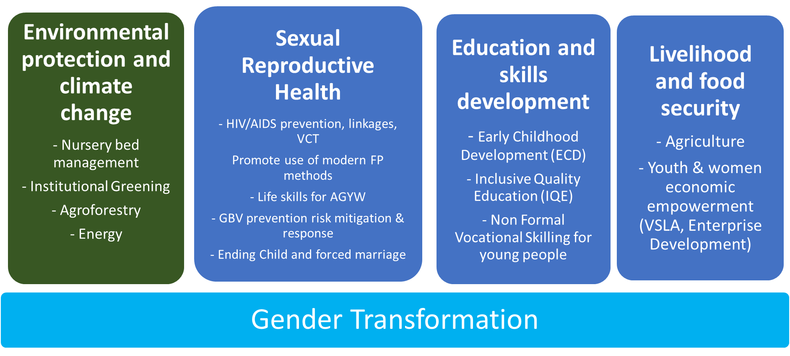
Thematic areas.

Slide 5
Personnel.
Projects’ status. SOYEE project year 2 contract signed for youth and women skilling. New project SUIDAC won pending signing of agreement with KMC.
Staffing. We currently have seven staff (3F:4M) with the ED as the head of the secretariat. Four staff are under SOYEE project and three are managed under the operation.

Slide 6
Percentage composition of staff by gender
Fig 1.

Slide 7
Program achievements.
In our core program areas of: livelihood and food security; education and skills development; and gender equality and transformation, This report presents a consolidated account of the achievements and challenges over the reporting year and further recommendations.

Slide 8
Education and skills development.
Trained 50 (36F:14M) youth on non-formal vocational skills like tailoring, hairdressing, catering & motorcycle mechanics. 14 (10F:04M) R & 36 (26F:10M) H.
Provided basic start up tools to start income generating activities 50 (36F:14M) participants who completed non formal vocational skills training.

Slide 9
Percentage of youth trained in various trades.

Slide 10
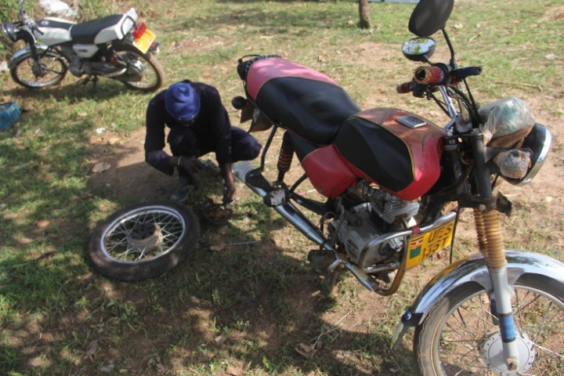
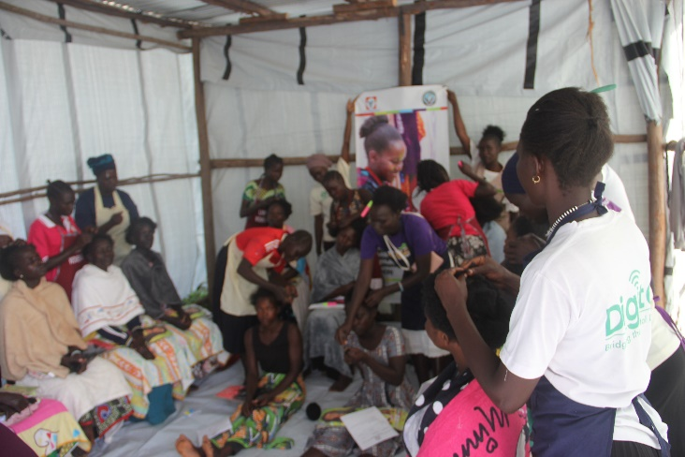
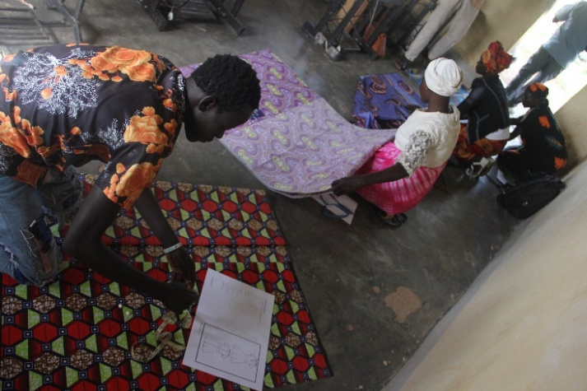
Photos of participants during vocational skills training.

Slide 11
Livelihood and food security.
15 youth-led VSLA groups were identified and formed (4 VSLA groups in Midia sub-county and 4 in Lobule sub-county) with each having 30 members. A total of 450(341F:109M) participants are engaged in VSLA
875 (616F:259M) young women and men reached through business mentorship and coaching sessions on financial literacy, record keeping and management, customer care, marketing, value addition, savings information, and investment.

Slide 12
Cont...
Digitized 15 VSLA groups. 45 (28F:17M) group leaders were trained on Digital Financial Services (DFS) and the use of Digital Agricultural Suite (DAS) tools. These leaders included Chairpersons, Secretaries, and Treasurers.
450 (333F:117M) VSLA group members provided financial literacy training.
Trained and supported 125 young women engaged in micro and/or small businesses with business stock for improved household incomes and dignified life.

Slide 13
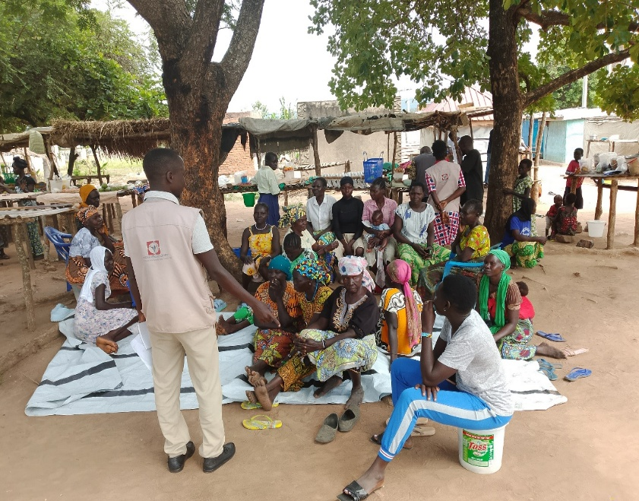
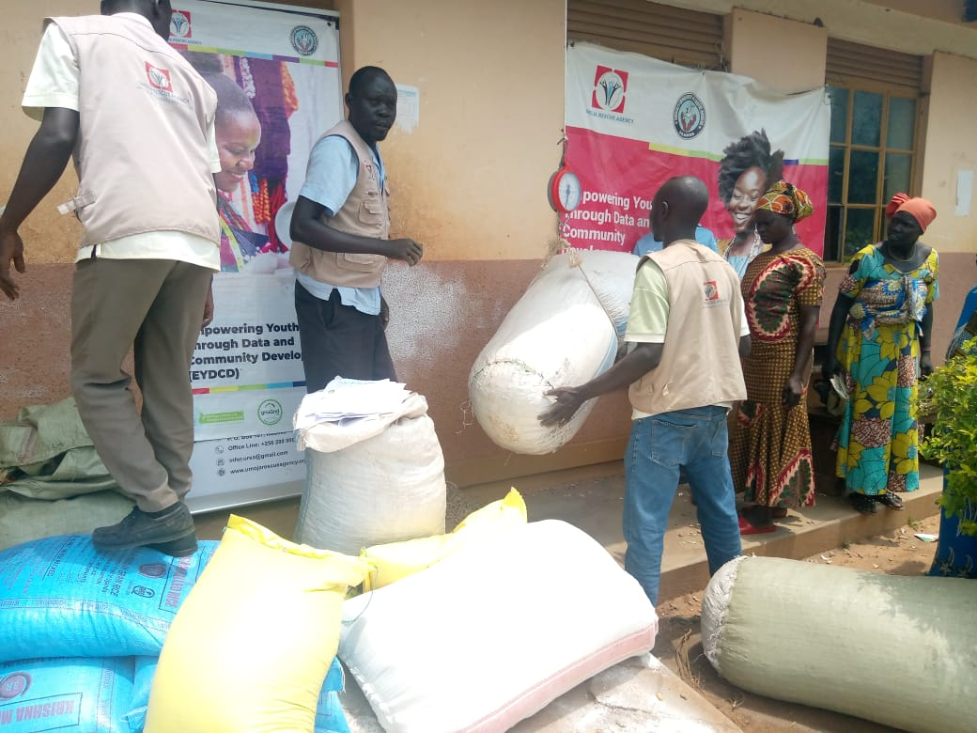
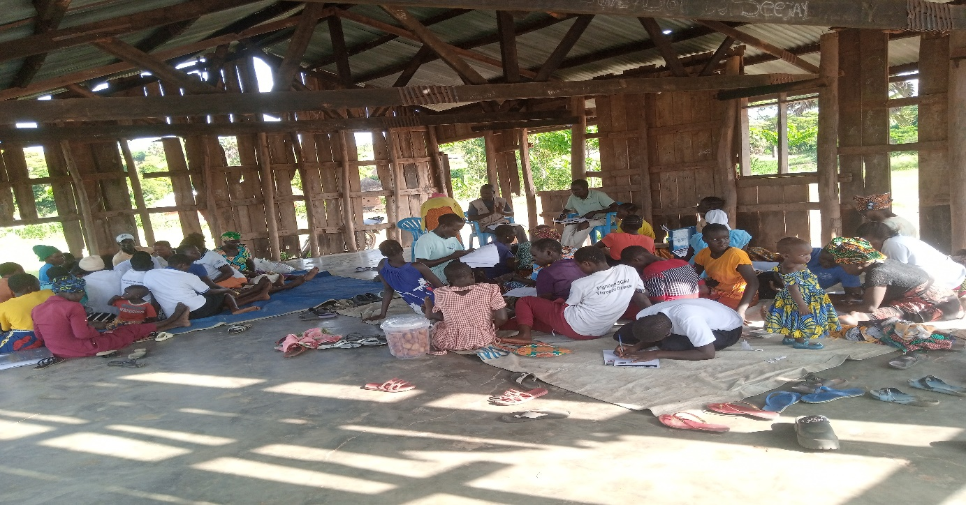
Photos during mentorship, VSLA savings & stock distribution.

Slide 14
Cross cutting issues.
Gender transformation. UREA ensured participation of women, girls, men, youth, and marginalized groups such as PWDs in all interventions.
Safeguarding. The organization policies have been integrated across programs. However some policies needs to be reviewed such as gender policy while there is also need for other policies to be developed like communication policy.

Slide 15
Cont…..
Partnerships and stakeholder engagement. UREA worked closely with government departments, community leaders, private sector, civil society organizations, and development partners to ensure effective and sustainable program delivery. This was achieved through coordination meetings, workshops and trainings.
Finance reporting system. UREA strengthened the finance system through installing accounting software (QuickBooks).

Slide 16
Cont…..
Compliance. UREA conduct audit for 2023 and 2024, renewed permit of operation, filled annual returns 2023&2024, acquired data protection certificate, complied with NSSF & URA, complied with donor guidelines, and all policies.
Monitoring and Evaluation: Strengthened M&E system through installing KPI software tracker and conducting routine monitoring, data collection, learning, and adaptive management.

Slide 17
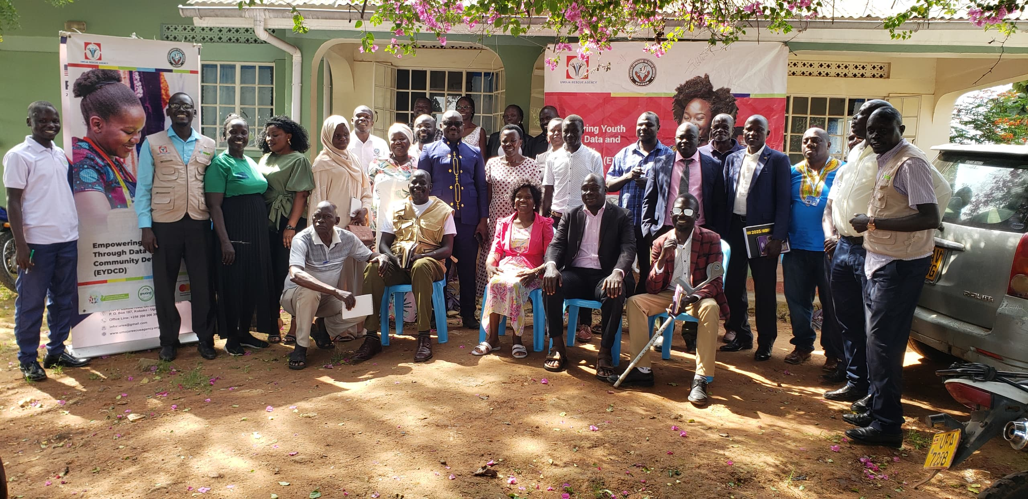
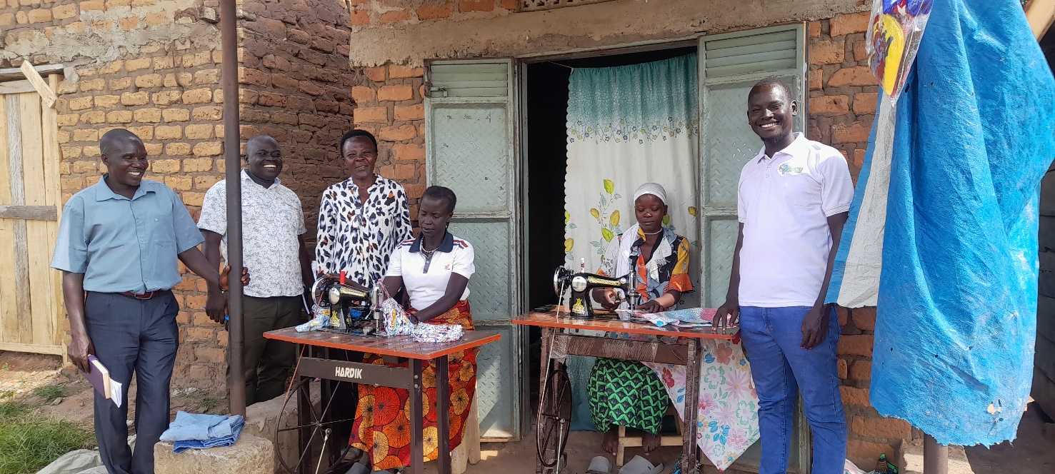
Photos taken during stakeholders meeting and monitoring.

Slide 18
Challenges
The existing office computers and printer have depreciated and conditions are in sorrow state. Only one computer is in excellent state without any disturbances.
Limited funding to other core programs areas such as health, governance, environment etc.
Limited assets like motorcycles and computers affected some of the projects’ activities. One staff at management level does not have a computer.
The political environment affected the team during activity implementation.
Delayed disbursement of year 2 funds for CRVPF slowed down our work.

Slide 19
Challenges
Limited staffing especially in the area of and M&E and finance. There is only 1 staff in finance department while there is no M&E staff.
Limited training opportunities to the staff, however mentorships and staff attending training organized by sister partners occurred.
Operating on rented premises which is expensive.
Minor accidents on staff were reported due to the bad roads resulting in to minor injuries sustained.

Slide 20
Recommendations.
Diversification of the sources of funding to the organisation.
Need to secure a permanent office premise for the operation of the organisation
There is need to plan for additional motorcycles and computers where possible to smoothen the operations.
More trainings needed to be organised for the staff on project management, fundraising and effective financial management so as to enhance their capacities and also a way of motivation.
Where resources will be realised, there should be a consideration for staff insurance.

Slide 21
Conclusion.
UREA has made significant progress in improving education outcomes and strengthening livelihoods and food security. We appreciate BOD for entrusting us with the responsibility of managing the affairs of this organization.
“Rescue humanity, save life”
Happy new year 2026.

